Slide 1
Unit 3
Industrial drives

Slide 2
Introduction
An industrial drive or electric drive is defined as a form of machine equipment designed to convert electric energy into mechanical energy and provide electrical control of this process.
Basic elements are electric motor, transmission and the control system.

Slide 3
Advantages of electric drive
available in wide range of torque, speed and power.
high efficiency
Does not pollute the environment.
It has no load losses and has considerable short time over loading capacity.
It can be started instantly and can be immediately fully loaded.
They are powered by electrical energy which has no of advantages compared to other forms of energy.
Speed control is easy and smooth.
Being compact it requires less space.
Can be remotely controlled.
Adaptable to almost any operating condition such as explosive environment, vertical mounting,etc

Slide 4
Disadvantages of electric drive
Comes to stop as soon as there is failure of electric supply.
Can not be used at far off places which are not served by electricity
However the above two disadvantages can be overcome by the use of diesel generator.

Slide 5
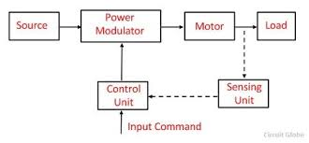
Functional block diagram of electric drive

Slide 6
Main parts of electric drive
Source
Power modulator
Control unit
Sensing unit

Slide 7
Source
it can be either ac source or dc source
Power modulator
The functions of power modulator are:
Regulates the output power from the source according to the load requirement.
Converts the energy according to the requirement of motor.
It also selects the mode of operation of motor
During transient operation it restricts source and motor currents within permissible limit.
In the electric drive system the power modulator can be any one of the following:
Controlled rectifier(ac to dc converters)
Inverters(dc to ac converters)
Ac voltage controllers(ac to ac converters)
Dc choppers(dc to dc converters)
Cyclo converters(frequency converter)

Slide 8
Control unit
Operates the power modulator as desired
Generates the command for power modulator according to the input command and output form the sensing unit
Sensing unit
Senses the certain drive parameters like motor current and speed
It is mainly required either for protection or for close loop operation

Slide 9
Classification of electric drive
According to mode of operation
Continuous duty drive
Short time duty drive
Intermittent duty drives
According to means of control
Manual
Semi automatic
Automatic
According to number of machines
Individual drive
Group drive
Multi motor drive

Slide 10
Classification of electric drive
According to dynamics and transients
Uncontrolled transient period drive
Controlled transient period drive
According to methods of speed control
Reversible and non reversible uncontrolled constant speed
Reversible and non reversible step speed control
Variable position control
Reversible and non reversible smooth speed control

Slide 11
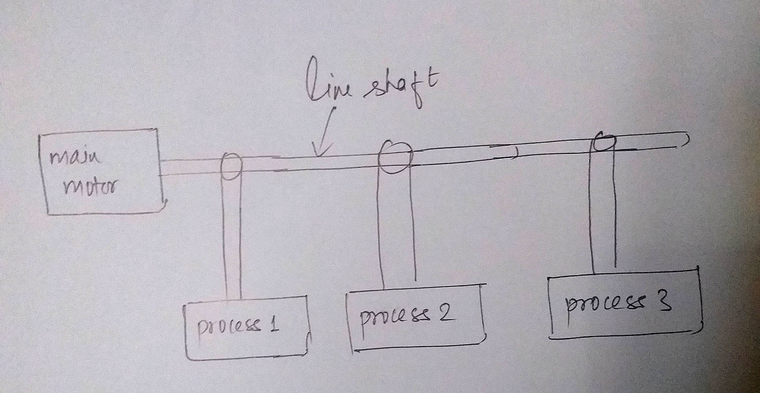
Group drive

Slide 12
Group drive
Single electric motor drives a line shaft by means of which an entire group of working machines may be operated
Also known as line shaft drive.
Line shaft is fitted with multi stepped pulleys and belts that connect the pulleys and shafts of the driven machines and serve to vary their speed.
Nowadays group drive is getting obsolete and modern trend is to employ individual or multi motor drive.

Slide 13
Advantages of group drive
This drive is economical in consideration of the initial cost of the motors and control gear.
The KW rating of the motor for group drive can often be less than the aggregate of KW output ratings of all the individual motors.
Efficiency and power factor of a large group drive motor will be higher provided that it is operated fairly near its rated load.
if the machines are sharply overloaded, group drive is advantageous.
Different speeds can be obtained by providing multi stepped pulleys and belts of different diameters.

Slide 14
Disadvantages of group drive
If single motor used develops fault, whole process will be stopped.
Speed control of individual machine is very cumbersome using stepped pulleys, belts, etc.
Owing to use of line shafting, pulleys and belts group drive does not give good appearance and is also less safe to operate.
Flexibility is lost because possibility of installation of additional machines in an existing system is limited and it is not possible to install any machine at a distant place.
Considerable power loss takes place in the energy transmitting mechanism
Level of noise is quite large

Slide 15
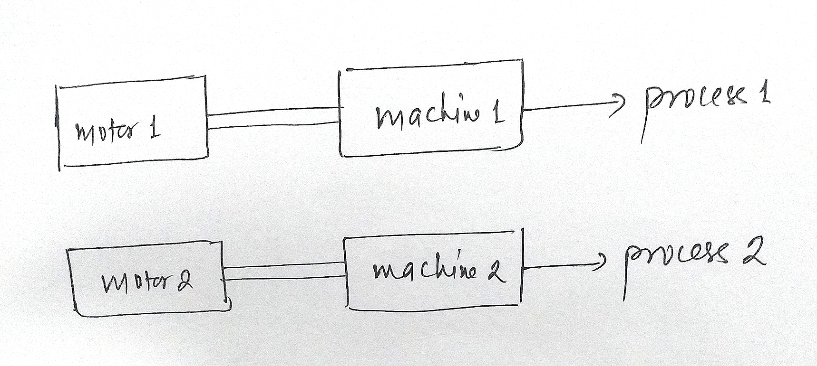
Individual drive

Slide 16
Individual drive
A single electric motor is used to drive one individual machine
It is essential where constancy of speed and flexibility of control is required.
Examples are drill machines, lathe machines, etc

Slide 17
Advantages of individual drive
Though expensive than group drive each operator has complete control of his machines which enables to vary speed if necessary and stop while not in use thus eliminating no load losses.
Machine can be placed at any desired position and can be moved very easily.
Motor and its control unit can be built as an integral part of the machine which results in good appearance, cleanliness and safety.

Slide 18
Disadvantages of individual drive
Only disadvantage is its high cost.

Slide 19
Multi motor drive
Consists of several individual drives which serves to operate one of many working members or mechanisms in some unit.
For example in travelling crane there are three motors one for hoisting, another for long travel motion and the third for cross travel motion.

Slide 20
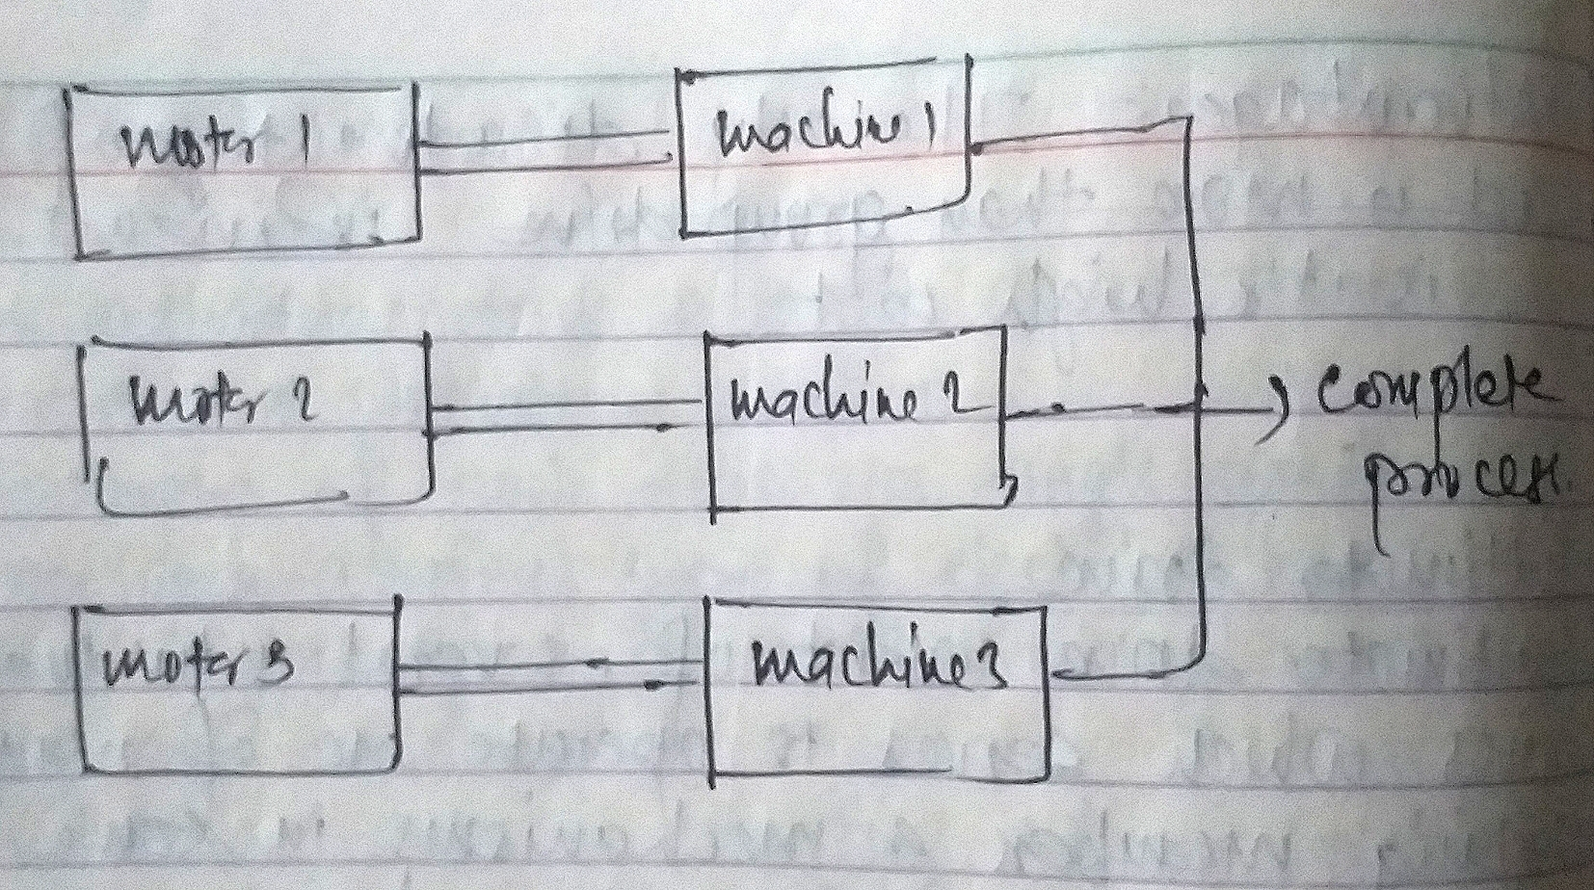
Multi motor drive

Slide 21
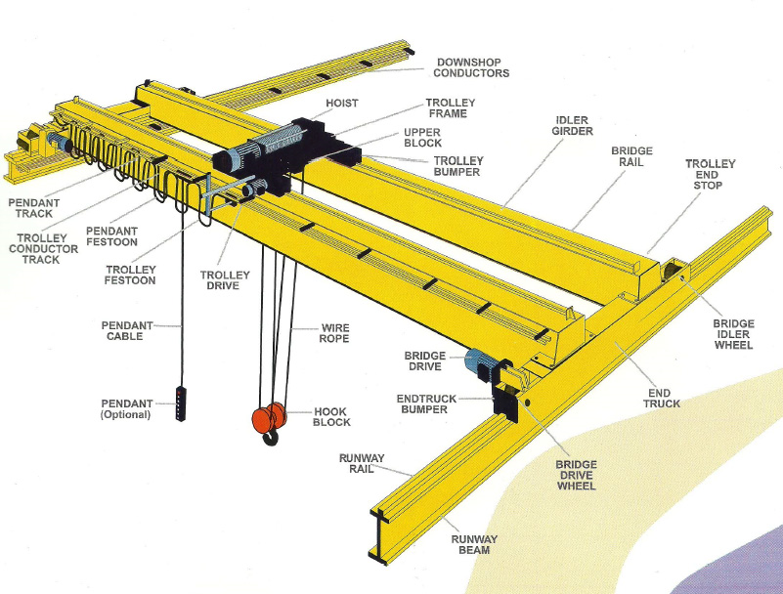
Multi motor drive

Slide 22
Advantages of multi motor drive
Automation in production processes along with reliability and safety operations
In case of motor fault only the respective motor will stop whereas other continue working

Slide 23
Disadvantages of multi motor drive
Most costlier drive among the three drives
More complexity than individual drive and group drive

Slide 24
Selection of electrical drives
Some of the important factors on which selection of electrical
drives are:
Steady state operation requirements: Nature of speed torque characteristics, speed regulation, speed range, Efficiency, duty cycle, quadrants of operation, speed fluctuations if any, ratings.
Transient operation requirements: Values of acceleration and deceleration, starting, braking and reversing performance.
Requirements related to the source: Type of source, and its capacity, magnitude of voltage, voltage fluctuations, power factor, harmonics and their effect on other loads, ability to accept regenerated power.
Capital and running cost, maintenance needs, life.
Space and weight restrictions if any.
Environment and location.
Reliability.

Slide 25
Dynamics of Motor Load System
A motor generally drives a load (Machines) through some transmission system.
While motor always rotates, the load may rotate or undergo a translational motion.
Load speed may be different from that of motor, and if the load has many parts, their speed may be different and while some parts rotate others may go through a translational motion.

Slide 26
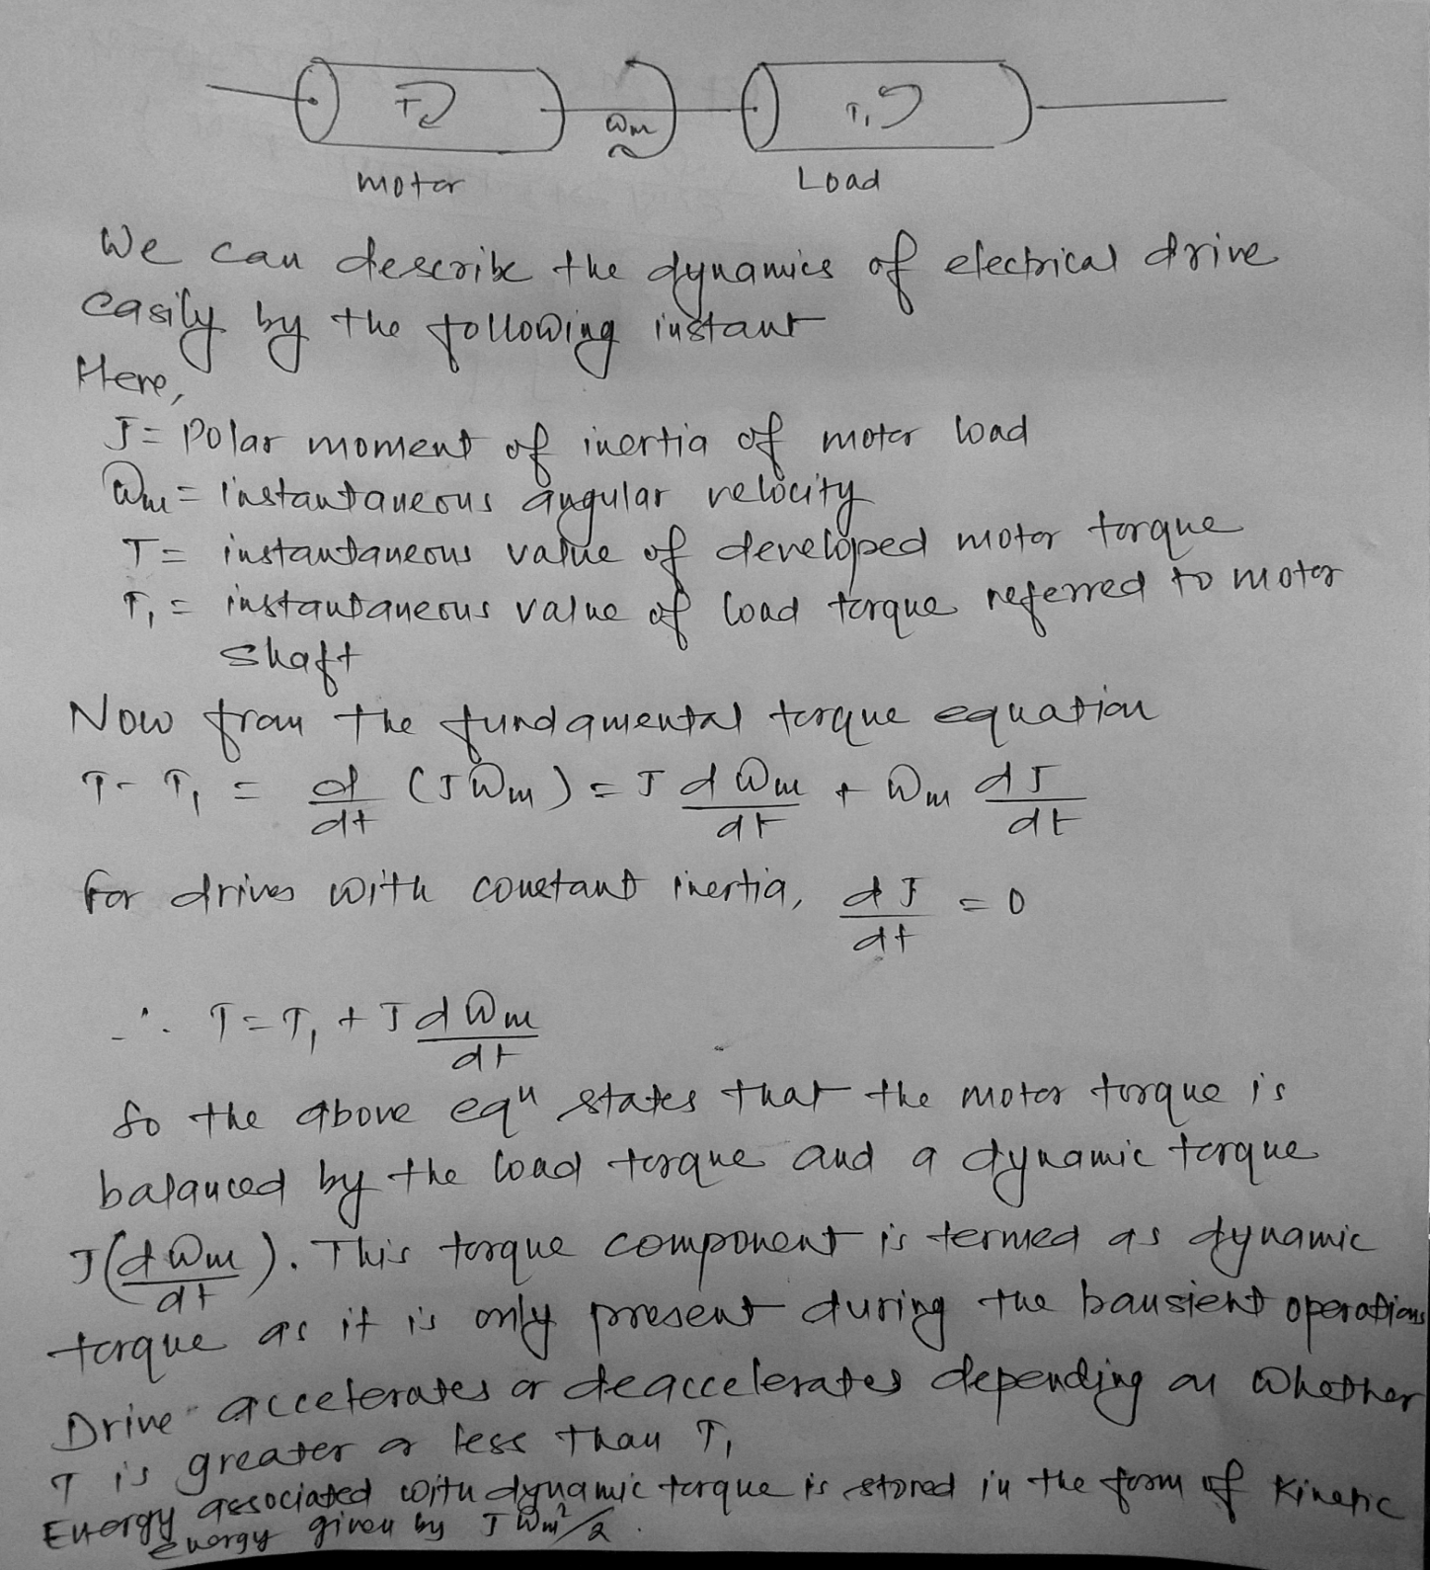

Slide 27
Classification of load torque
Active Load torques
Passive Load torques

Slide 28
Active Load torques
Such load torques usually retain their sign when the direction of the drive rotation is changed.
Torque due to gravitational force, tension, compression and torsion, undergone by an elastic body, come under this category.

Slide 29
Passive Load torques
Load torques which always oppose the motion and change their sign on the reversal of motion are called Passive Load Torques.
Such torques are due to friction, windage, cutting etc.

Slide 30
Components of load torque
Friction torque T_{F}
Windage torque, T_{w}
Torque required to do the useful mechanical work, T_{L}

Slide 31
Friction torque T_{F}
Friction will be present at the motor shaft and also in various parts of the load.
T_{F} is equivalent value of various friction torques referred to the motor shaft.

Slide 32
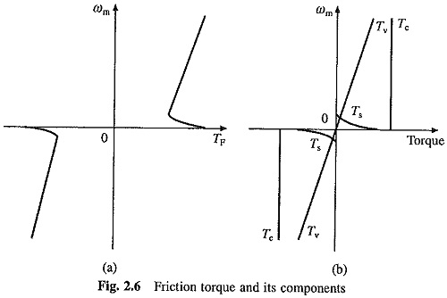
Variation of friction torque with speed and components of friction torque

Slide 33
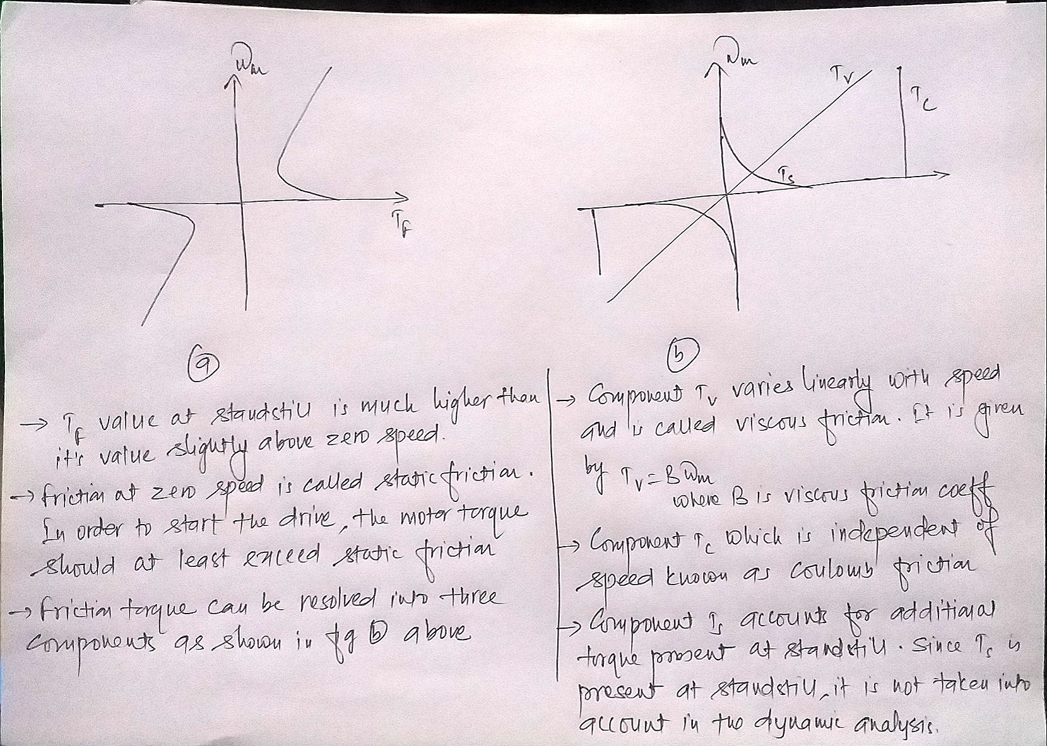

Slide 34
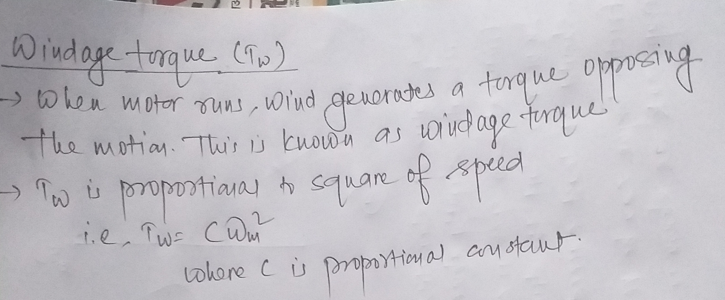
Windage torque, T_{w}

Slide 35
Torque required to do the useful mechanical work, T_{L}
Nature of this Components of Load Torques depends on particular application.
It may be constant and independent of speed; it may be some function of speed
it may depend on the position or path followed by load
it may be time invariant or time-variant
it may vary cyclically and its nature may also change with the load’s mode of operation.

Slide 38
Speed torque characteristics of different types of load
Different types of loads exhibit different speed torque characteristics.
Most of the industrial loads can be classified into the following 4 general categories:
1. Constant torque type load.
2. load with torque proportional to speed (generator type load)
3. load with torque proportional to square of the speed (fan type load)
4. load with torque inversely proportional to speed (constant power type load)

Slide 39
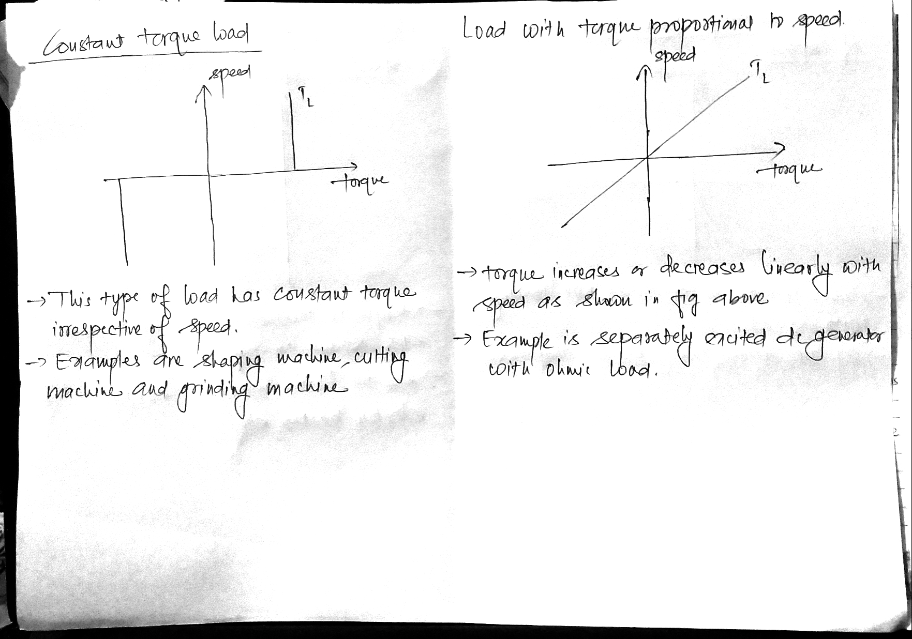

Slide 40
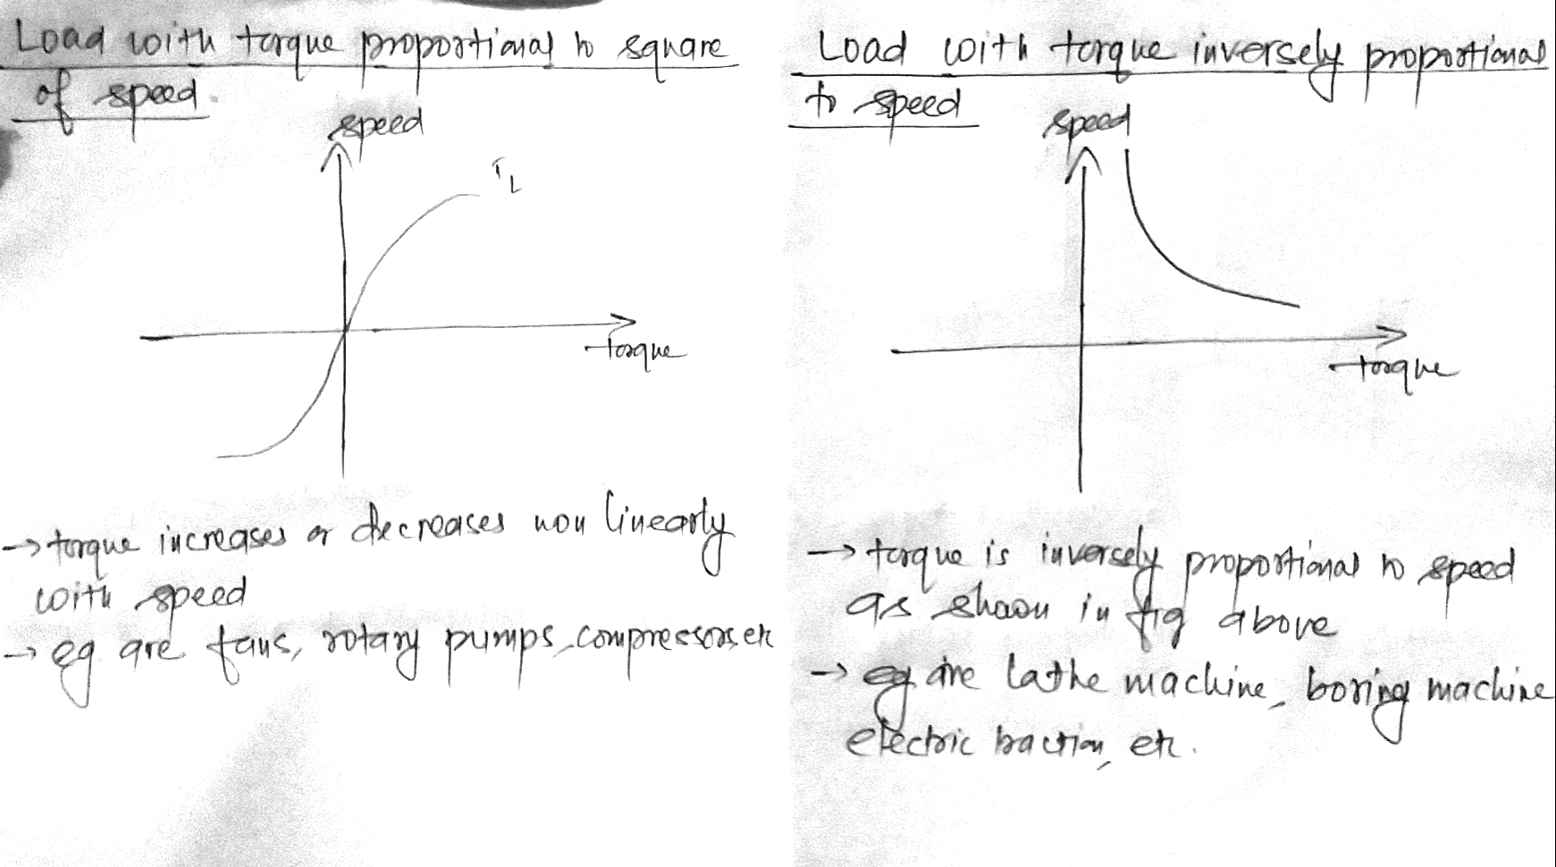

Slide 41
Steady state and transient stability
The drive is said to be in equilibrium if the torque developed by the motor is exactly equal to the load torque and the corresponding speed is called equilibrium speed.
If the drive comes out of the state of equilibrium due to some disturbance, it comes back to steady state for stable equilibrium but for unstable equilibrium the speed of the drive increases uncontrollably or decreases to zero.
Stability: the stability of the motor load combination is defined as the capacity of the system which enables it to develop forces of such a nature as to restore equilibrium after any small departure therefrom.
There are two types of disturbances:
1. Changes from the state of equilibrium takes place slowly and the effect of the inertia is insignificant which is related to steady state stability.
2. Sudden and fast changes from the equilibrium state so effect of inertia can not be neglected which is related to dynamic or transient stability.

Slide 42
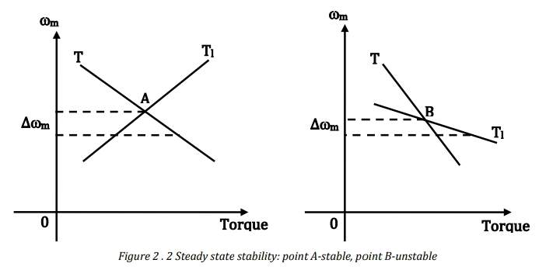

Slide 43
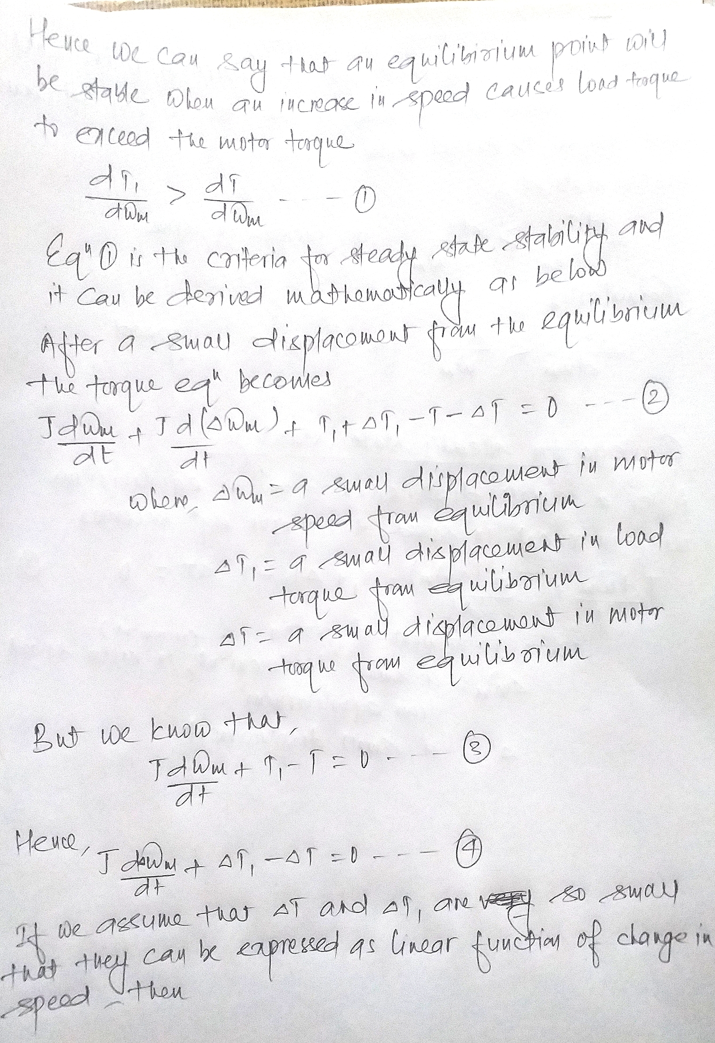

Slide 44
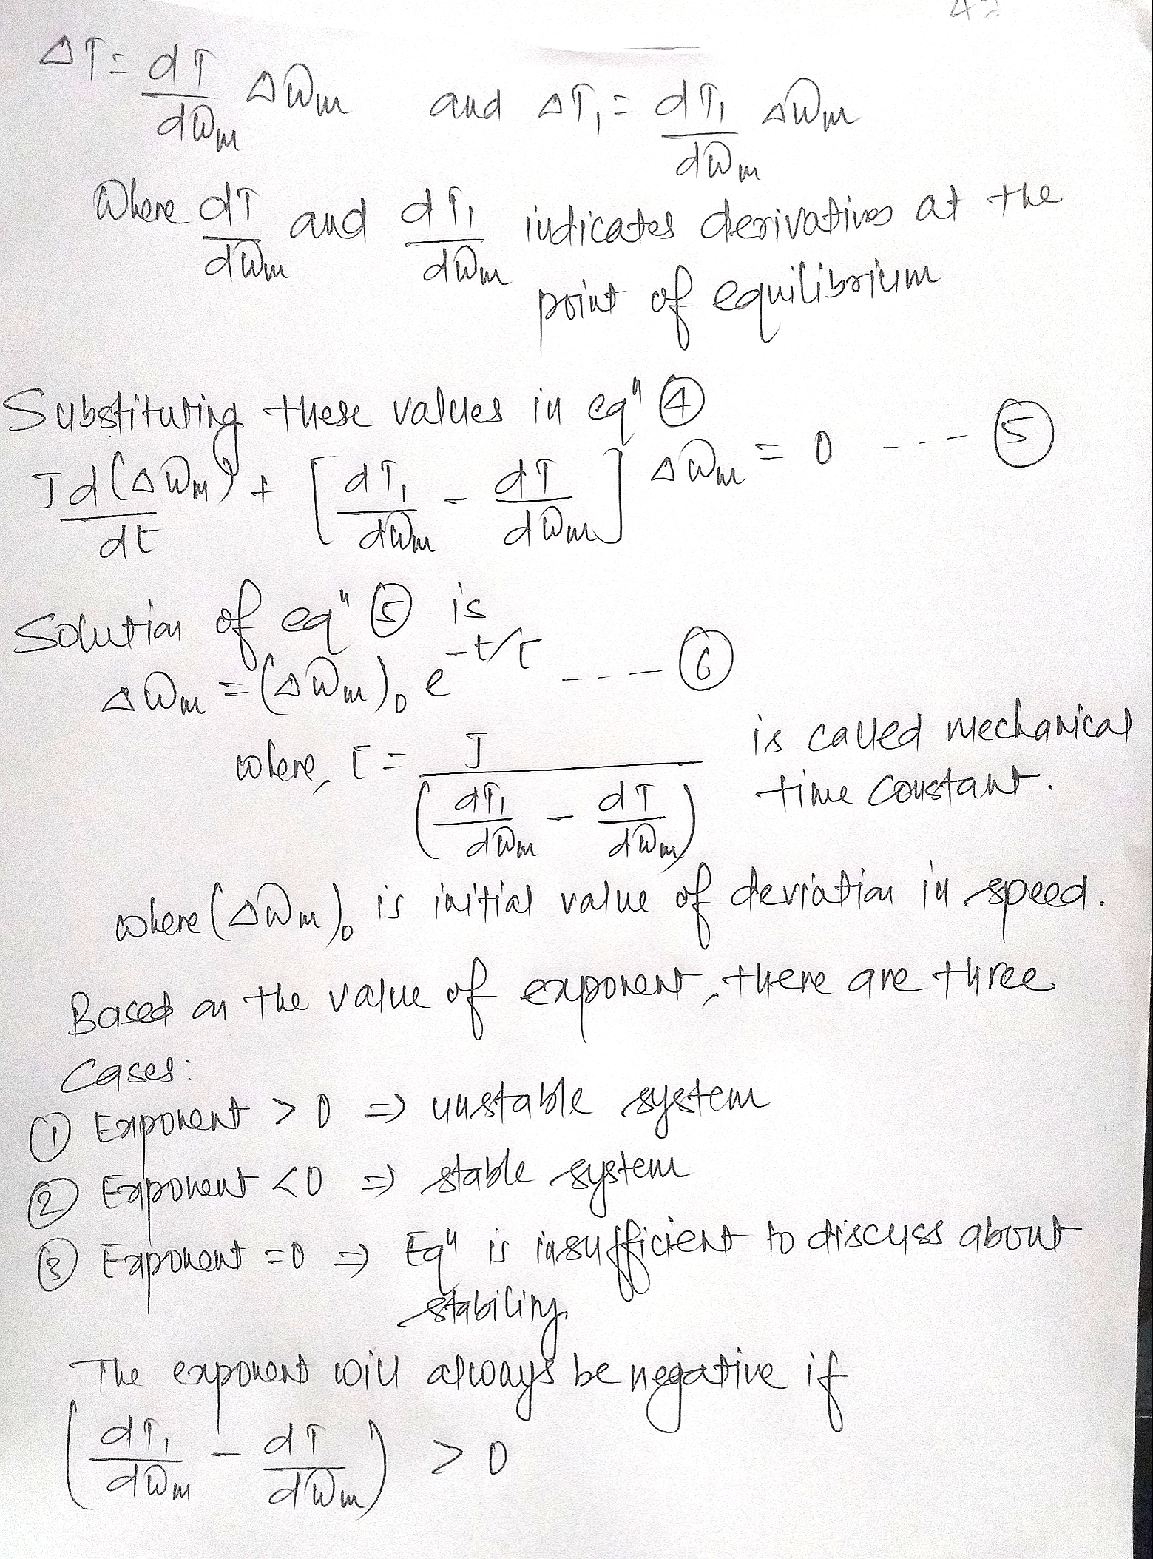

Slide 45
Selection of motor power rating(motor sizing)
The size and power rating of motors for any
service depends upon the following factors:
Heating effect
Classes of duty or loading condition
Inertia of load
Environmental condition

Slide 46
Heating effect
The maximum temperature rise of motor under given load condition is limited which is governed by the insulation.
If the temperature goes beyond the temperature the insulation can bear, the windings will be short circuited or motor may be permanently damaged.
The different factors that governs the temperature rise are:
1. Heating
2. Dissipation of heat
3. Specific heat capacity

Slide 47
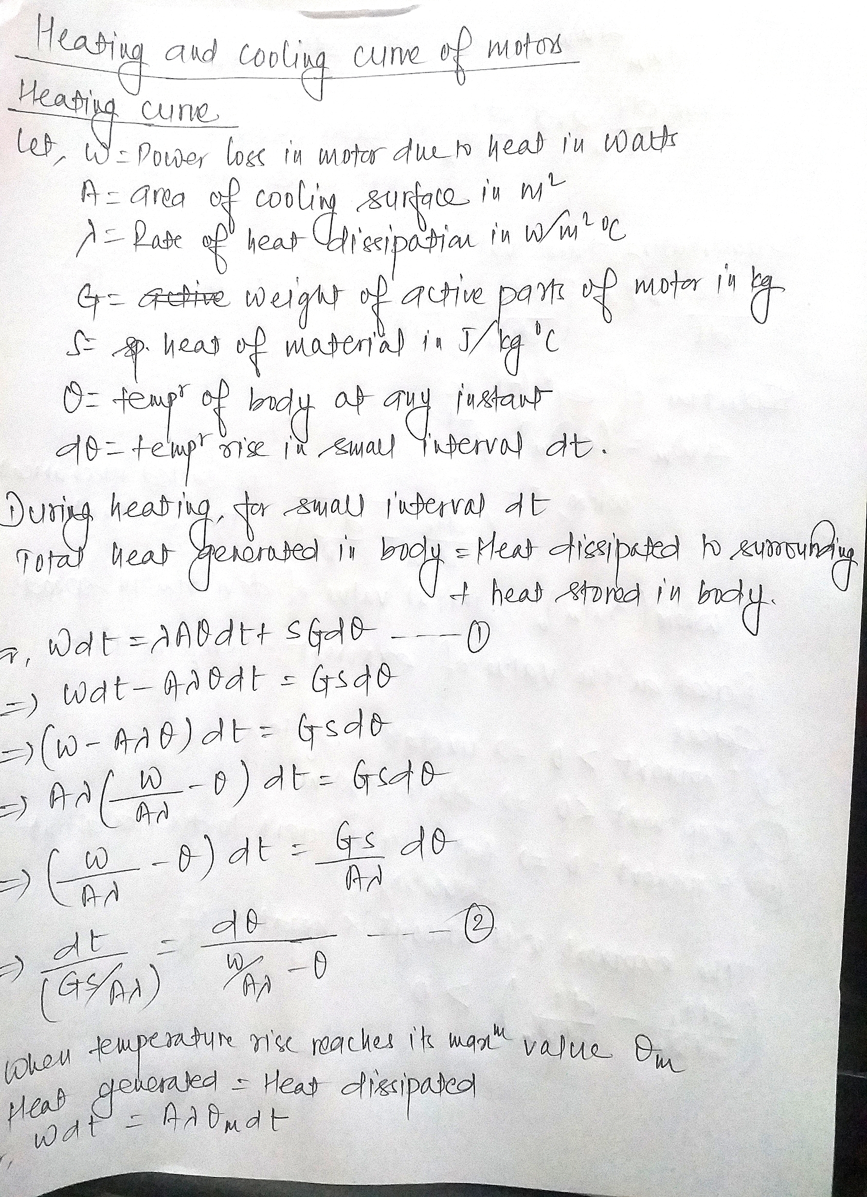

Slide 48
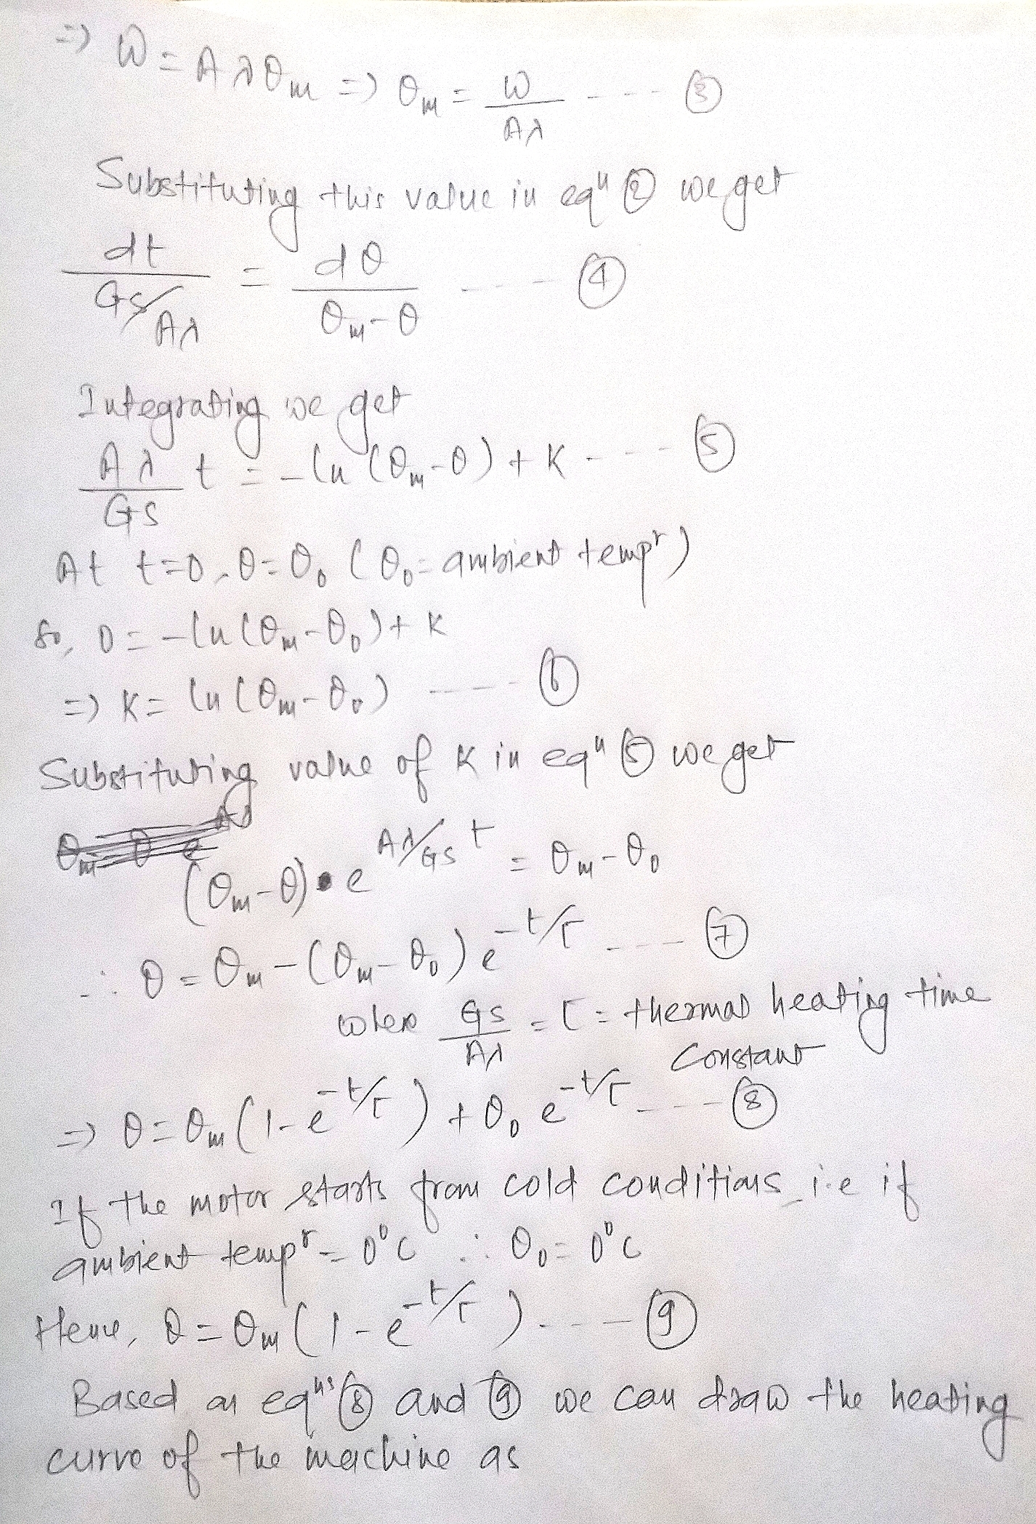

Slide 49
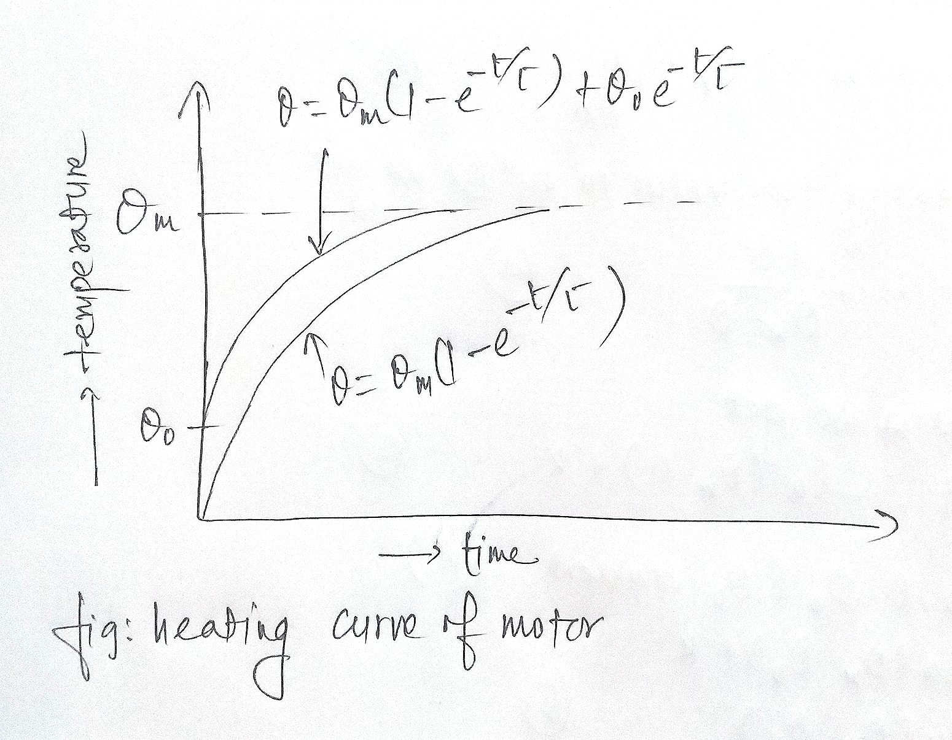

Slide 50
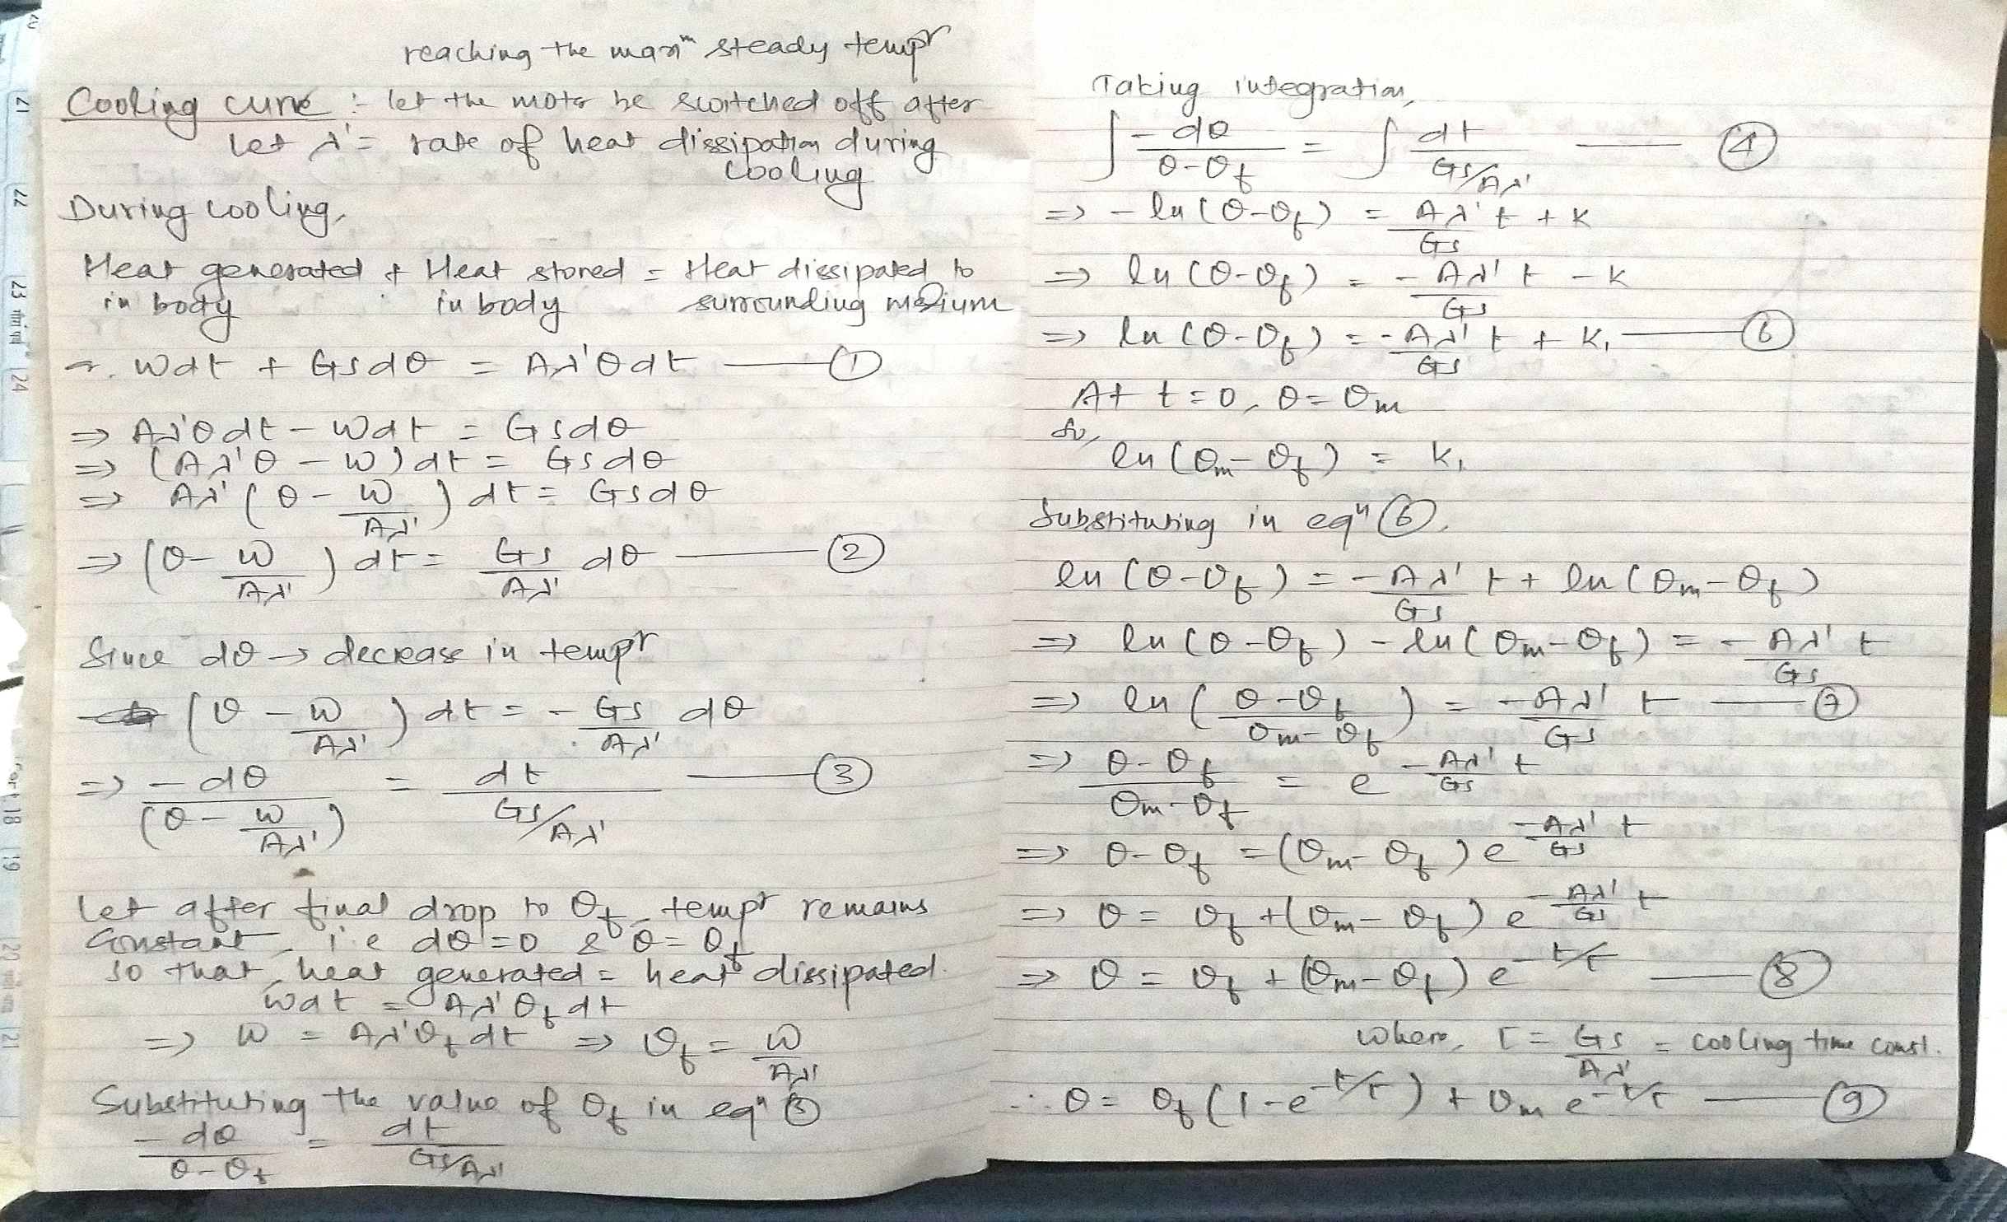

Slide 51
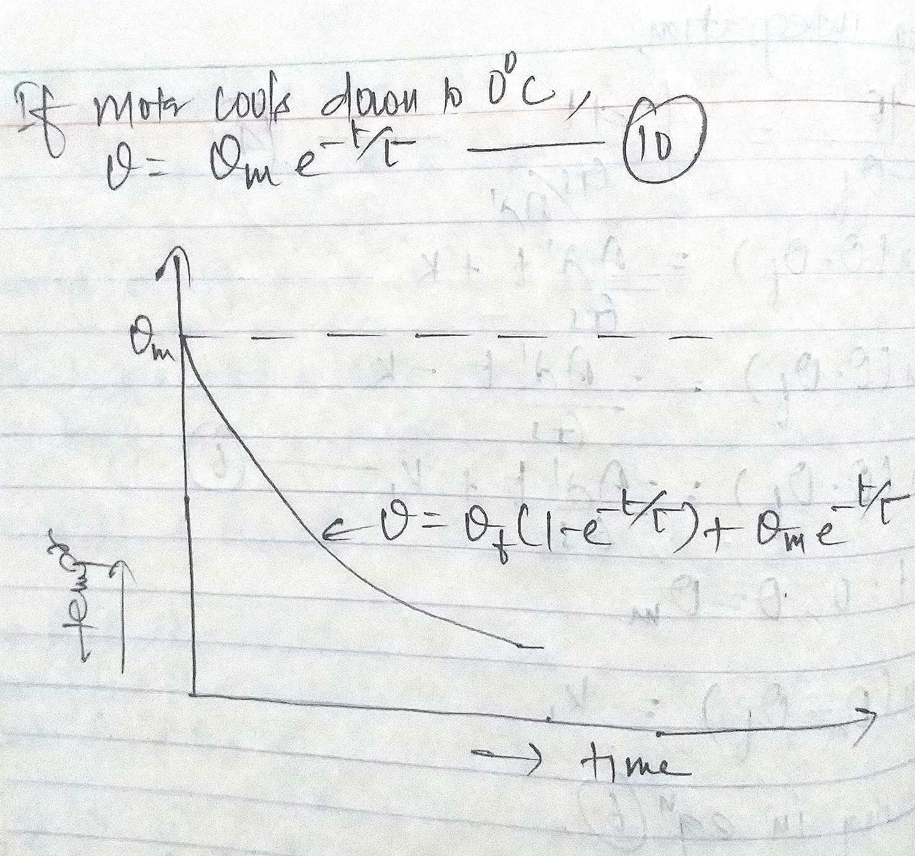

Slide 52
Classes of motor duty in electric drives
The rating of the motor selected from the viewpoint of heating depends upon the load condition or duty to which it is subjected.
According to the load condition the classes of duty are:
1. Continuous duty.
2. Short time duty.
3. Intermittent periodic duty.
4. Intermittent periodic duty with starting.
5. Intermittent periodic duty with starting and braking.
6. Continuous duty with intermittent periodic loading.
7. Continuous duty with starting and braking.
8. Continuous duty with periodic speed changes.

Slide 53
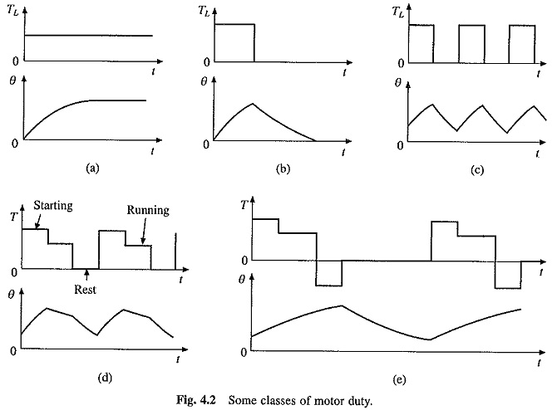

Slide 54
Continuous duty.
Motor is running long enough and the motor temperature reaches the steady state value.
Employed to drive fans, compressors, etc.

Slide 55
Short time duty
Time of operation of motor is very low and the heating time is much lower than the cooling time so that the motor reaches the ambient temperature before operating again.
Employed for opening and closing weirs, lockgates and bridges.
Recommended values of short time duty are 10, 30, 60 and 90 minutes.

Slide 56
Intermittent periodic duty
Motor operates for sometime and then there is rest period. In both the conditions the time is insufficient to raise the temperature to steady state value or cool it to the ambient temperature.
Employed for hoisting mechanism, trolley buses, etc

Slide 57
Intermittent periodic duty with starting
This is intermittent periodic duty where heat losses during starting cannot be ignored.
It consists of a period of starting, a period of operation at a constant load and a rest period; with operating and rest periods, being too short for the respective steady-state temperatures to be attained.
In this duty, heating of machine during braking is considered to be negligible, because mechanical brakes are used for stopping or motor is allowed to stop due to its own friction.

Slide 58
Intermittent periodic duty with starting and braking
This is the intermittent periodic duty where heat losses during starting and braking cannot be ignored.
It consists of a period of starting, a period of operation with a constant load, a braking period with electrical braking and a rest period with operating and rest periods being too short for the respective steady state temperatures to be attained.

Slide 59
Continuous duty with intermittent periodic loading.
This Classes of Motor Duty in Electrical Drives is distinguished from the intermittent periodic duty by the fact that a period of running at a constant load is followed by a period of running at no load instead of rest.

Slide 60
Continuous duty with starting and braking.
Consists of periodic duty cycle, each having a period of starting, a period of running at a constant load and a period of electrical braking; there is no period of rest.

Slide 61
Continuous Duty with Periodic Speed Changes
Consists of periodic duty cycle, each having a period of running at one load and speed, and another period of running at different speed and load; again both operating periods are too short for respective steady-state temperatures to be attained.

Slide 62
Types of Motor rating
Continuous rating
Continuous maximum rating
Short time rating

Slide 63
Continuous rating
This is an output which a motor can deliver continuously without exceeding the permissible temperature rise.
Can deliver 25 percent overload for 2 hours.

Slide 64
Continuous maximum rating
Similar to continuous rating but not allowing any overload.
Used for motors of capacity larger than 1.84 KW

Slide 65
Short time rating
This is an output an electric motor can deliver for a specified period (say 0.5 hour, 0.25 hour, etc) without exceeding the permissible temperature rise.

Slide 66
Determination of power ratings of electric motors for different applications
Continuous duty and constant load
Continuous duty and variable load
Short time rating

Slide 67
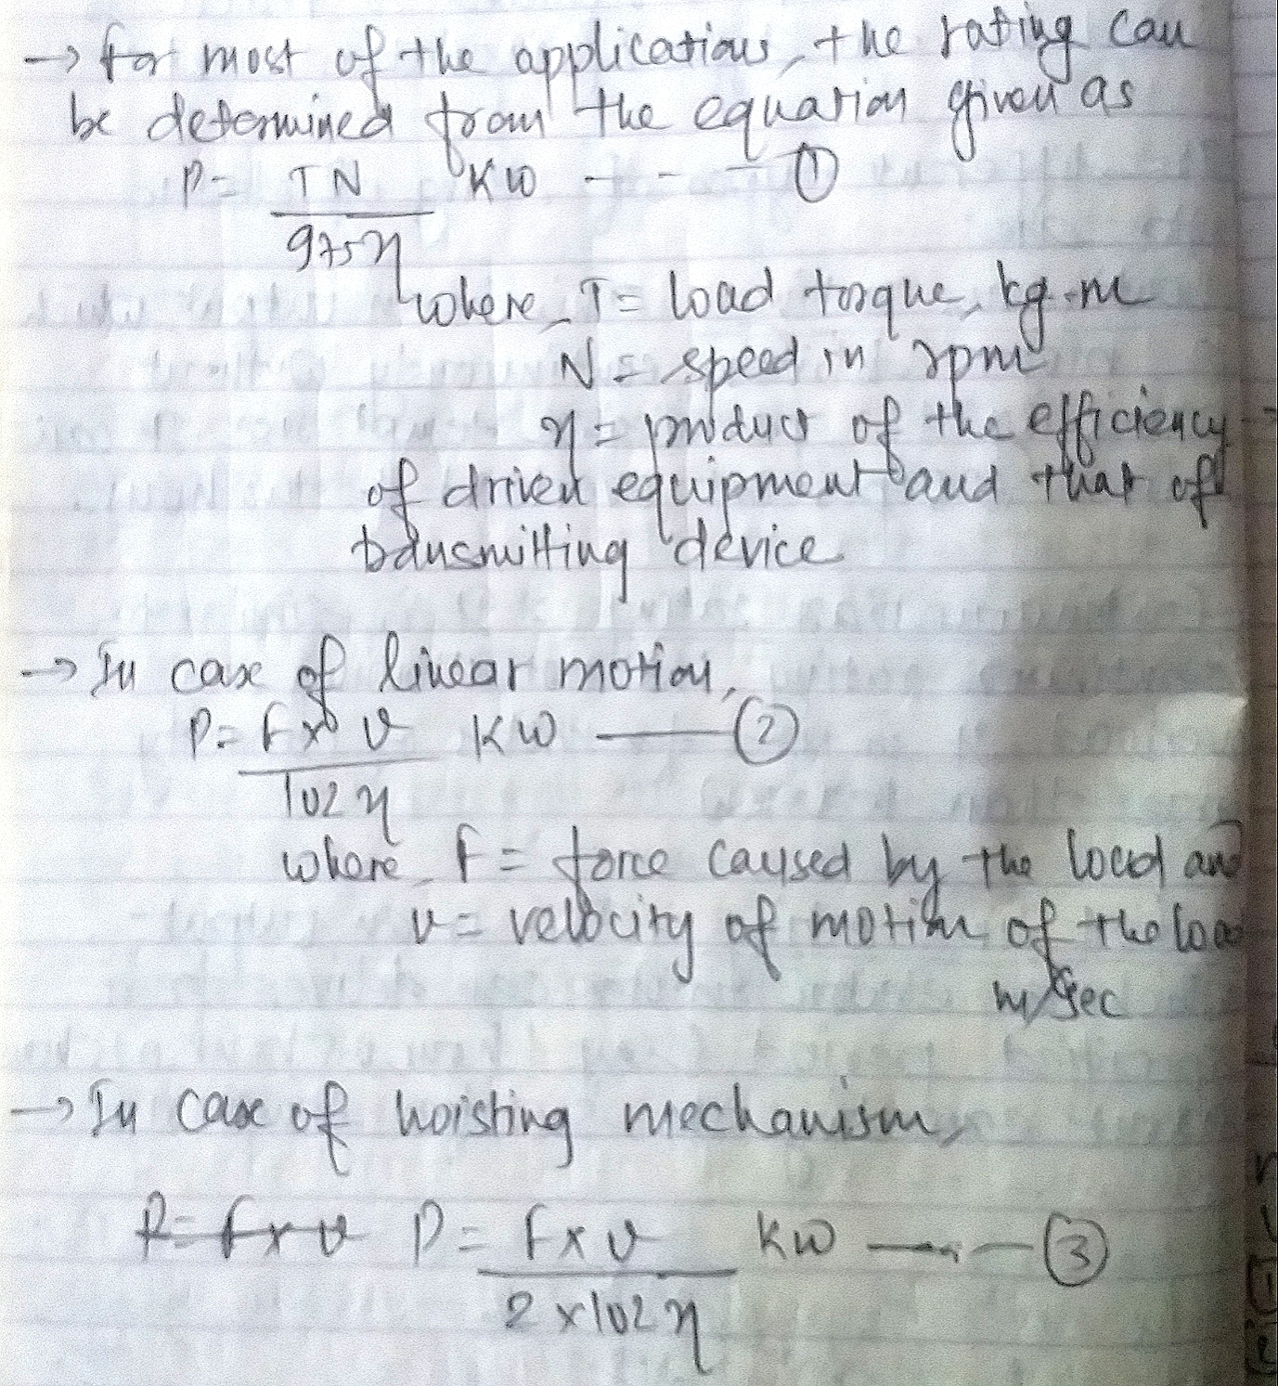
Continuous duty and constant load

Slide 68
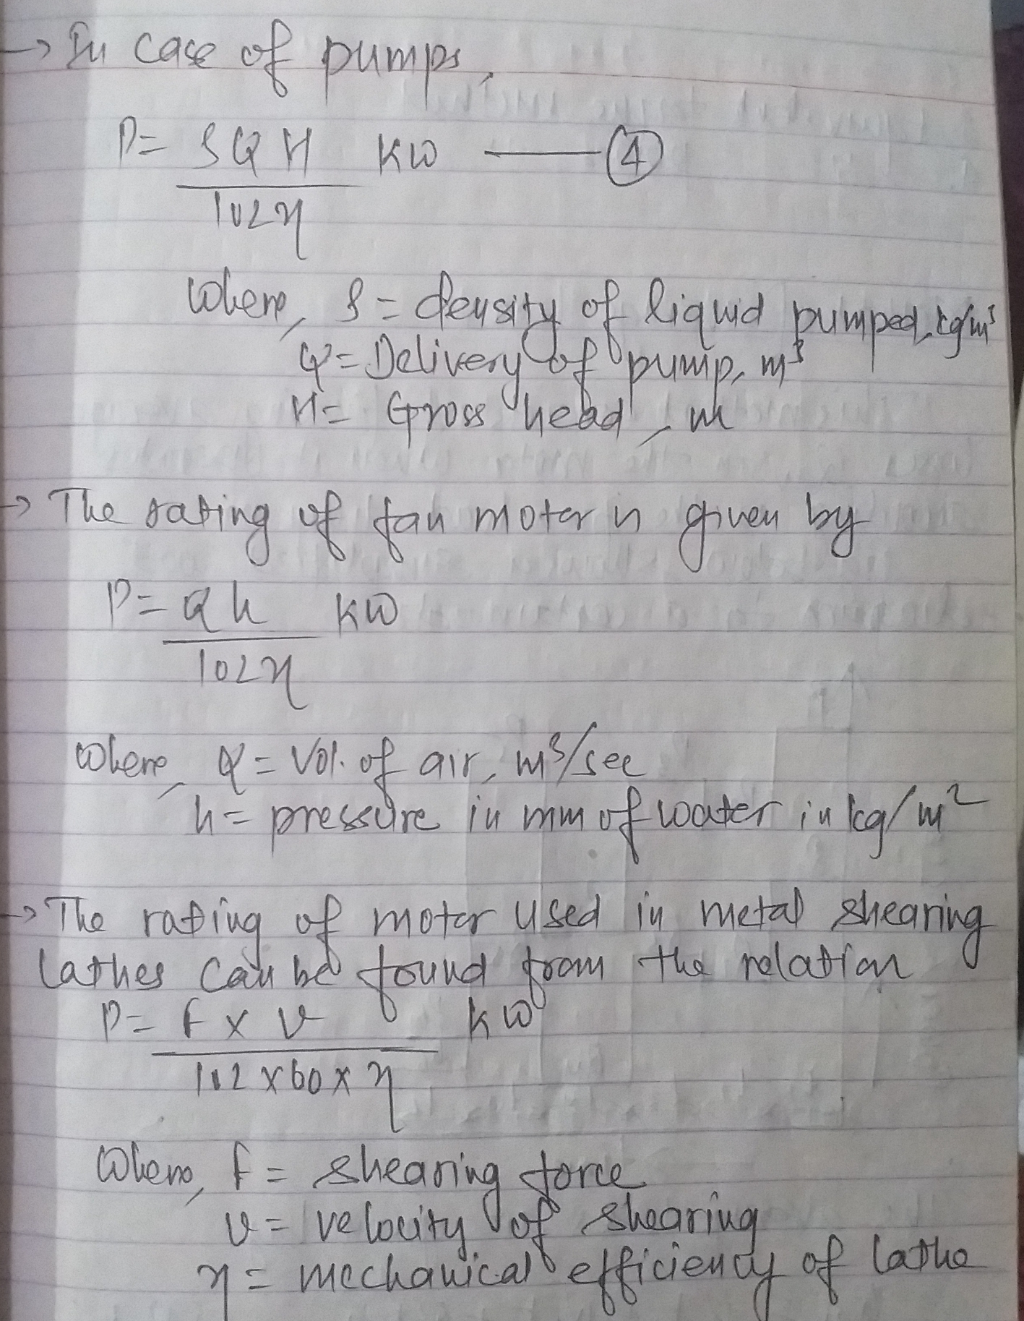
Continuous duty and constant load(contd)

Slide 69
Continuous duty and variable load
Different methods employed for determination of motor rating for variable load drives are:
1. Method of average losses
2. Equivalent current method
3. Equivalent torque method
4. Equivalent power method

Slide 70
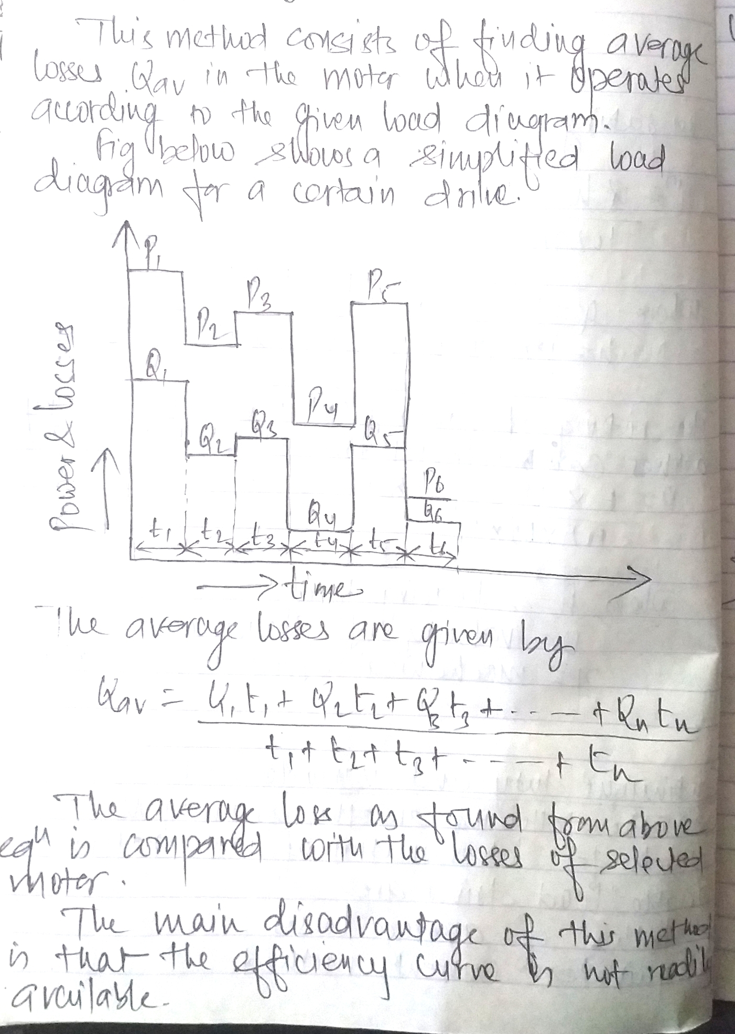
Method of average losses

Slide 71
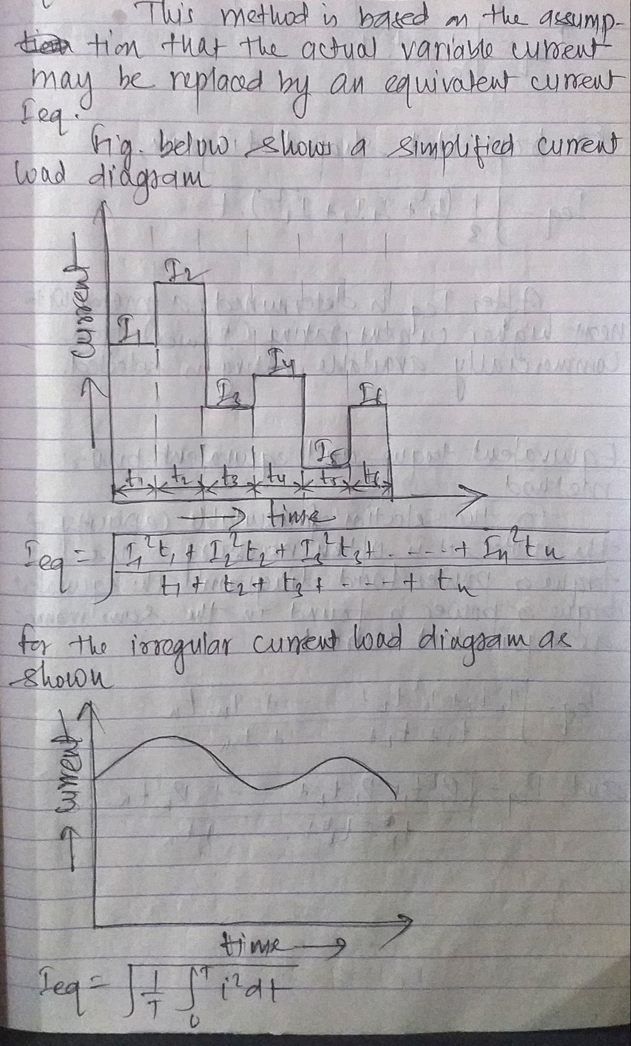
Equivalent current method

Slide 72
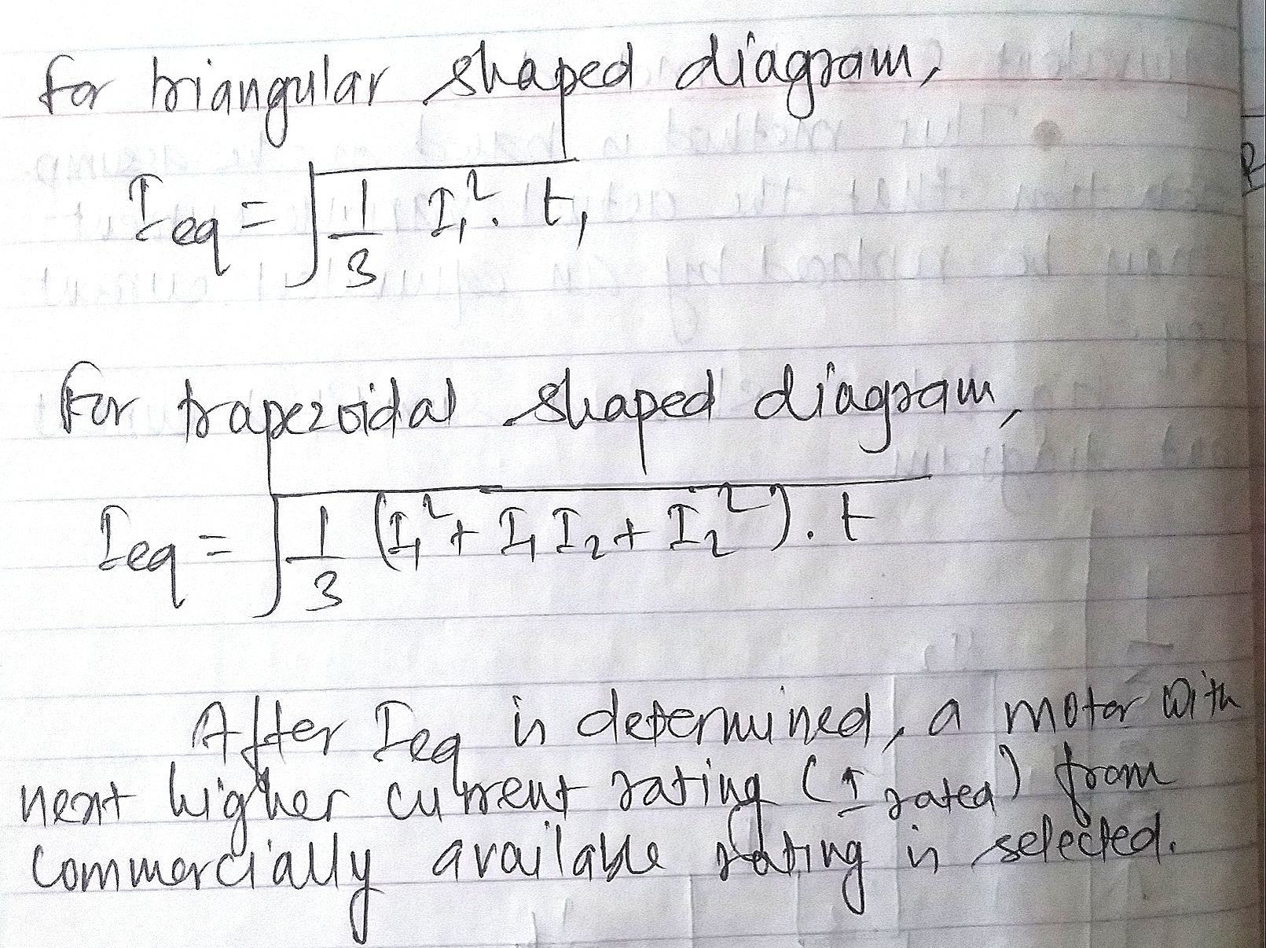
Equivalent current method(contd)

Slide 73
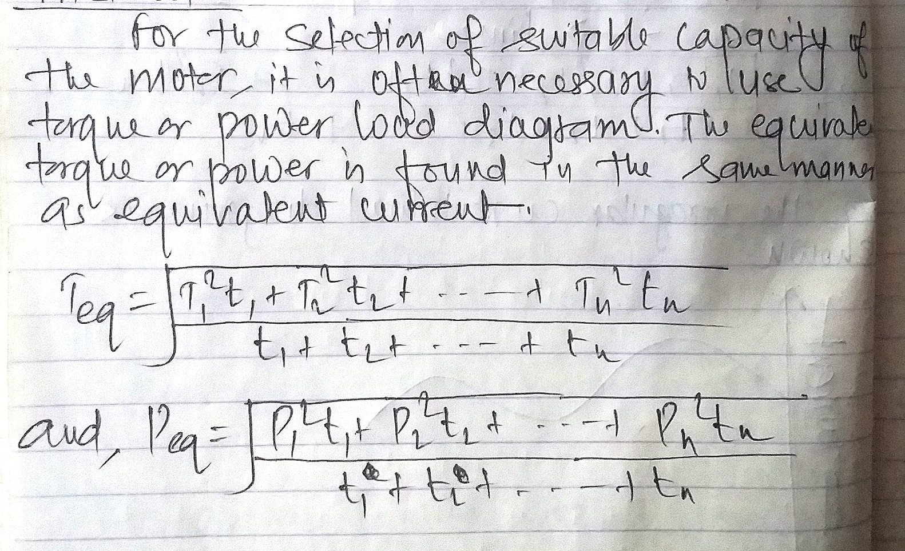
Equivalent torque and power method

Slide 74
Load equalization and flywheel sizing
The process of smoothing out the fluctuating load is called load equalization.
It is necessary because most of the industrial drives have fluctuating load and during time of peak load it will draw very high current from the supply which will either produce large voltage drop in the supply system or require cables of higher cross section.

Slide 75
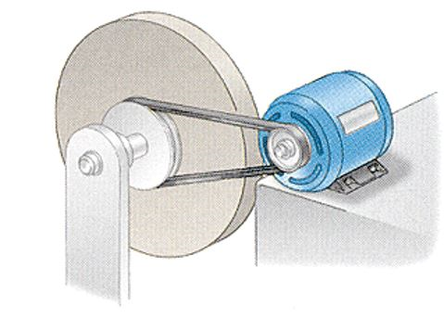
Load equalization and flywheel sizing(contd)

Slide 76
Load equalization and flywheel sizing(contd)
The process of load equalization involves the storage of energy during light load periods which can be given out during peak load periods.
Load equalization is achieved by means of a flywheel which is mounted on the motor shaft if the speed of the motor is not to be reversed.
During intervals of heavy load speed of motor tends to decrease which enables the flywheel to release a portion of the stored K.E to meet the demand of load.
During off peak load period motor draws more energy than required by the load. The excess energy is again stored as K.E in flywheel whose speed then increases.

Slide 77
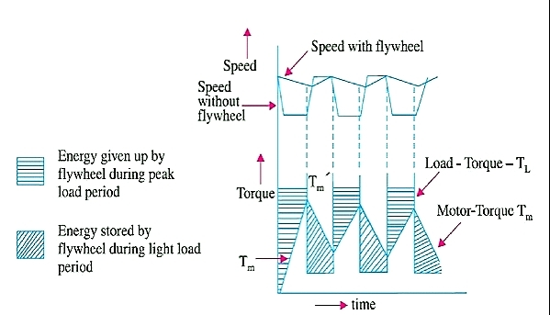
Variation of load torque, motor torque and speed with time

Slide 78
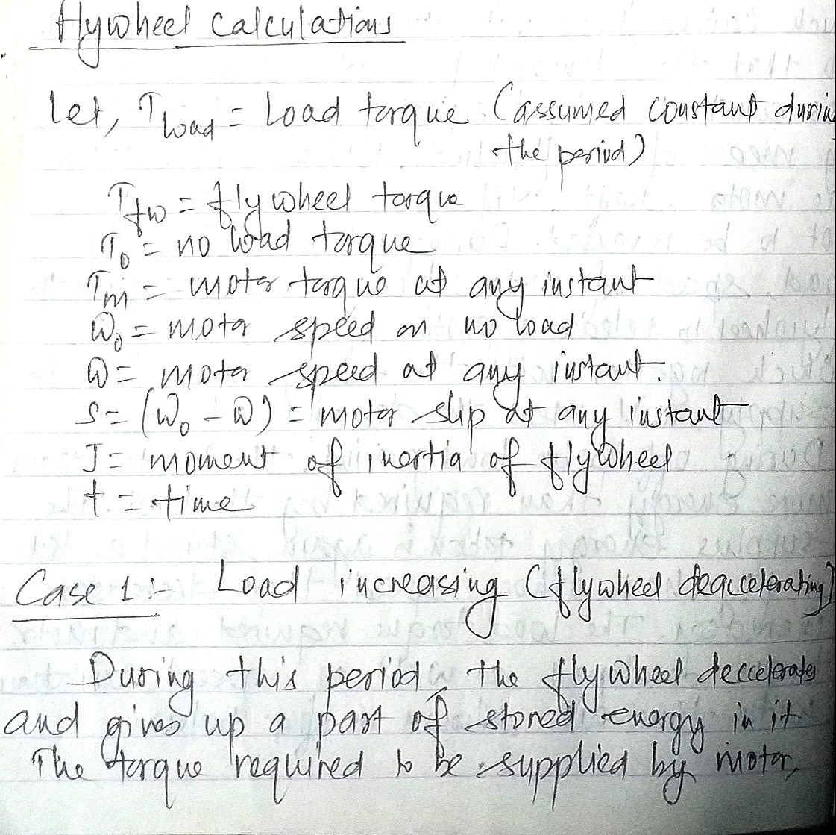

Slide 79
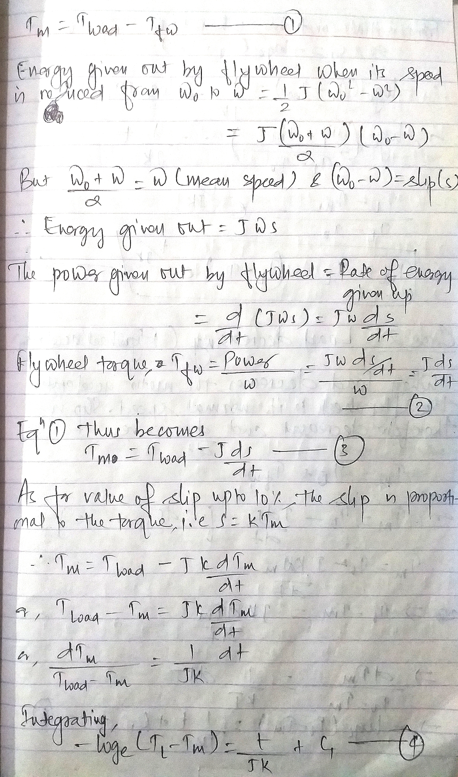

Slide 80
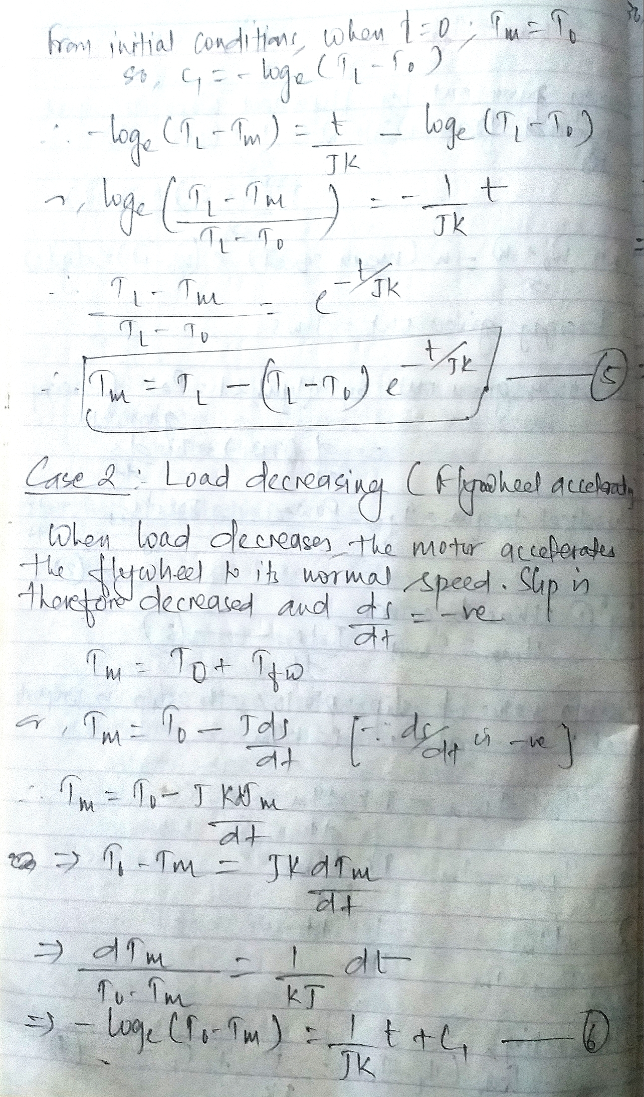

Slide 81
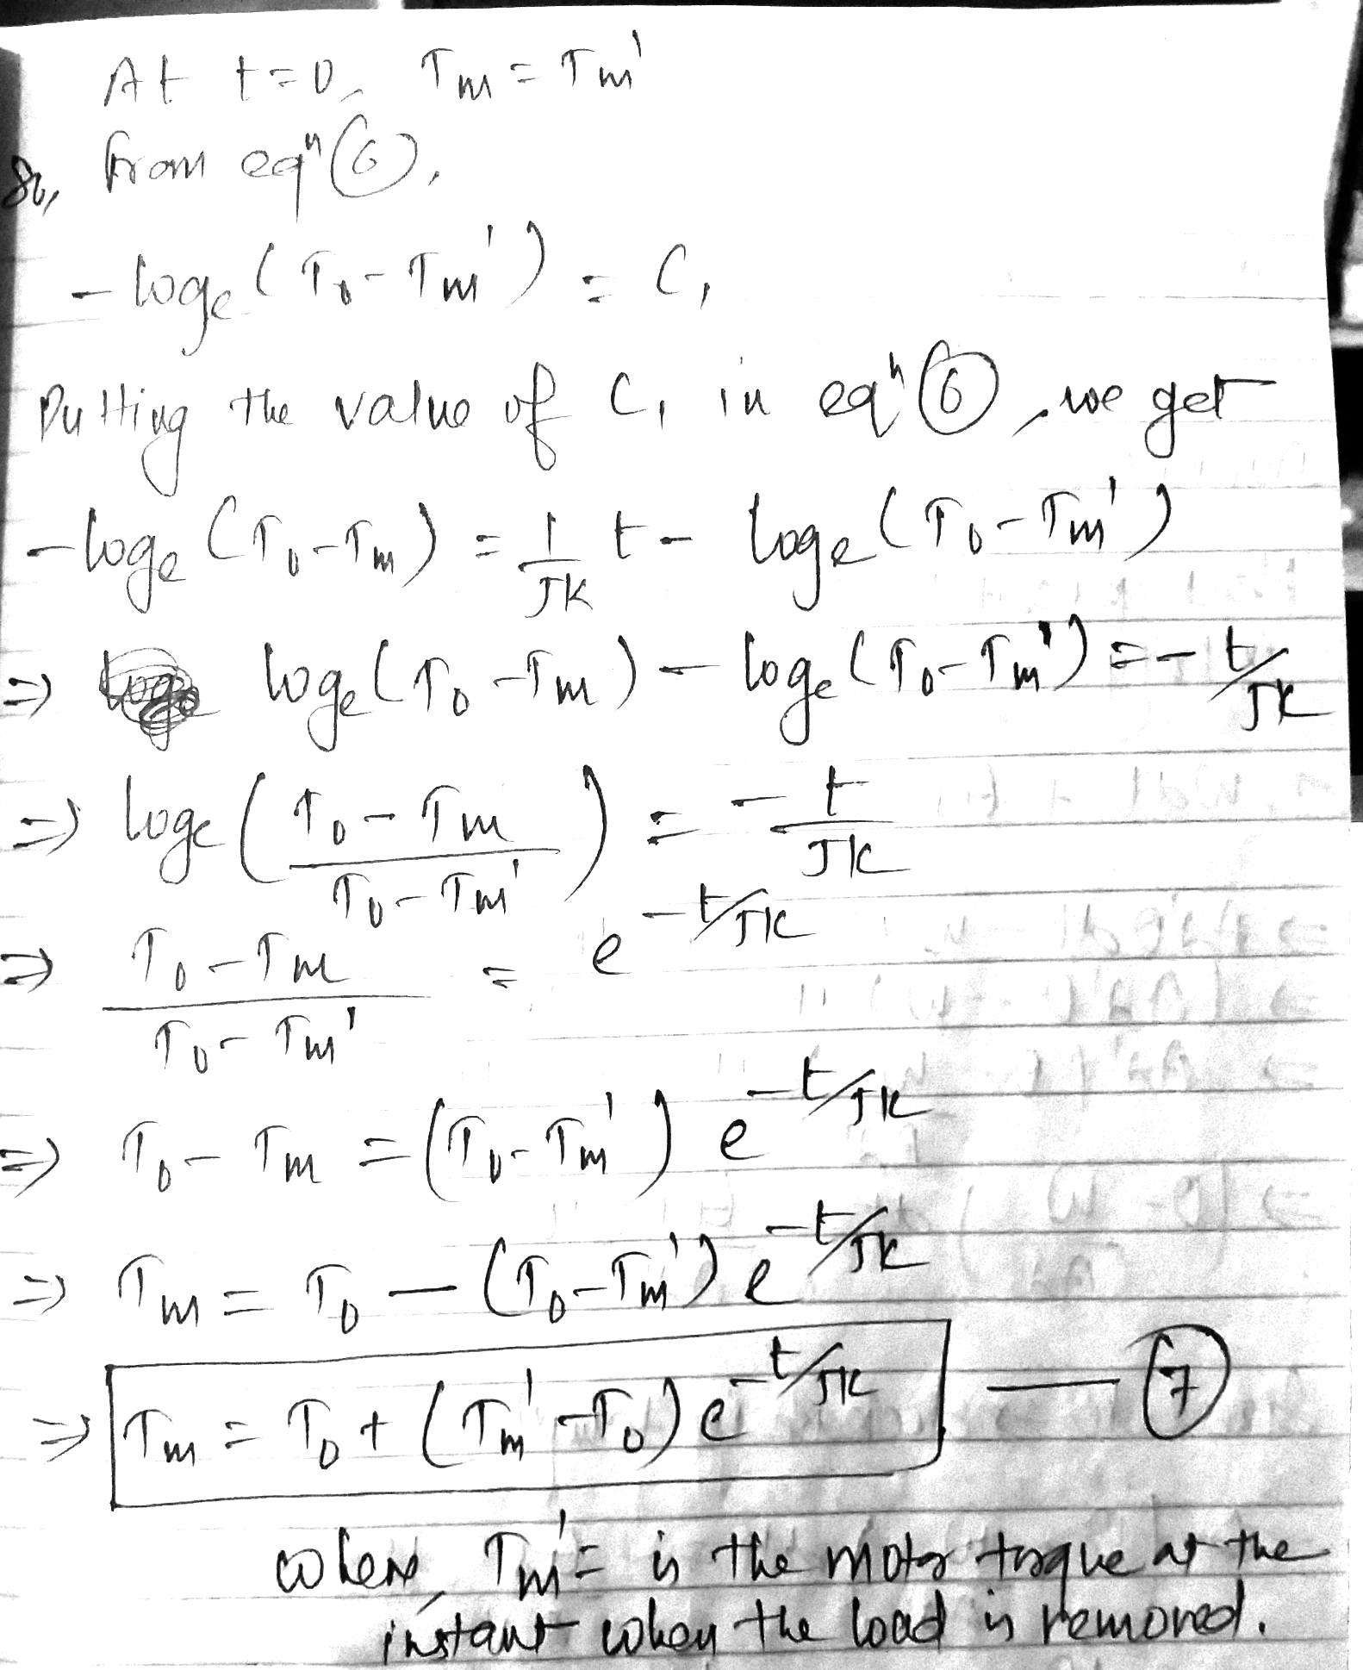

Slide 82
Electric drives for different applications
Domestic uses
Machine tool drives
Cranes and hoist work
Lifts
Lathes, milling and grinding machines
Planers
Punches, presses and shears
Shapers and slotters
Blowers and fans
Frequency converters
Drilling machines
Air compressors
Electric traction
Pumps
Refrigeration and air conditioning
Breweries
Excavators
Belt conveyors
Flour mills
Quarrying
Wood working machinery
Printing machinery
Petrochemical industries
Sugar mills
Cement mills
Mining work
Textile mills
Woolen mills
Paper mills
Ship-propulsion
Rolling mills

